Slide 1
BANK DATABASE MANAGEMENT SYSTEM by Neel Lalit Shah (001029882) Bryan Michael Pereira(001020476) Naga Prudhvi Gandikota(001027075) Jayachandra Chimakurthi(001065324)

Slide 2
SUMMARY
The Bank Database Management System will make the storing, processing and utilization of all the customers, employees as well as transaction details of any bank simpler and convenient.
A Bank that has a lot of feature offers and options is considered the best Bank, but those are also the reasons that make a Bank Database System complicated.
This project includes all types of bank transactions, Deposit& Withdrawal, Credit& Debit cards.

Slide 3
SUMMARY
It also has features like Insurances and Loans.
Loans include House, Education, Personal and Car loans at varying interest rates.
Insurances include Life Insurance, Car Insurance and many others.
The bank has 24-hour ATMs for cash withdrawal at many places

Slide 4
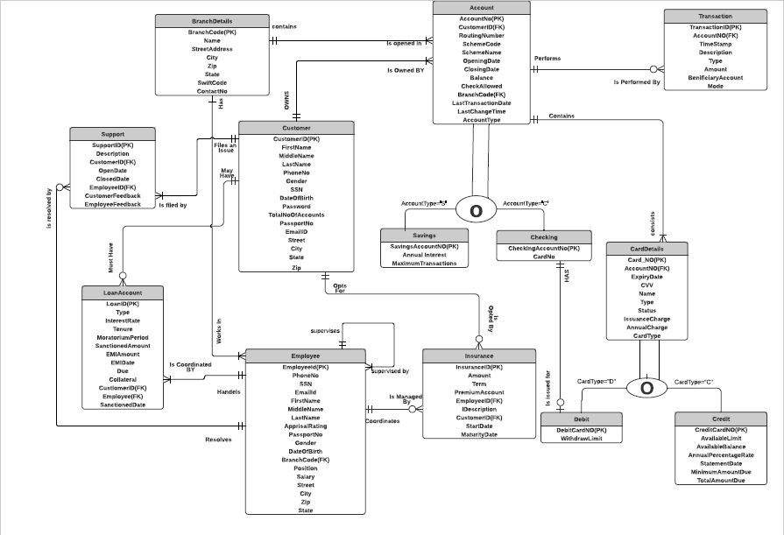
E-R Diagram

Slide 5
SQL DDL statements
We have used IDENTITY property to specify a counter of values for primary key column of a table.
CHECK constraints are used to limit the value range that can be placed in a column.
Th customer password is Encrypted using the algorithm AES_256.
Non Clustered Indexes are created on LastName and Email_id columns of customer and employee table and OpenDate column of Support table for faster retrieval of data during query processing.

Slide 6
Stored Procedures
We have created six stored procedures for performing business logic.
The Create_Customer procedure is for creating customers.
The Create_Account procedure is for creating accounts, we have used subtype discriminator to differentiate the type of accounts(S for Savings and D for Checking).
The Create_Card procedure is for creating cards based on customer request, we have used subtype discriminator to differentiate the types of cards( D for Debit and C for Credit).

Slide 7
Stored Procedures
The Get_Credentials procedure is to fetch customer decrypted data.
The Credit_Transaction procedure is called by a trigger when the transaction if the done by the credit card and updates the credit table attributes.
The Other_Transactions procedure is called by a trigger when the transaction is done by a customer by using any mode other than credit card and get update in the Account Table.

Slide 8
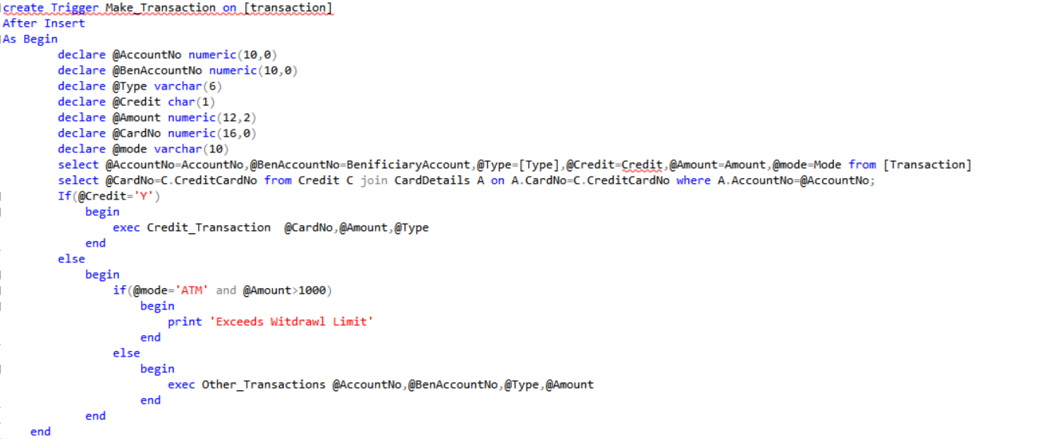
Triggers
The Make_transaction trigger will be fired implicitly when a triggering INSERT statement is issued on the Transaction table and updates the customer account table.

Slide 9
Views
Views are created for business users needs and this are helpful to generate reports .
This views contain a set of data used for analysis purpose. For example CreditVersusState view contains the state wise credit utilization data versus total credit limit issued.
InsuranceAccountsVersusEmployee view contains the data related to the Insurance accounts opened by an employee.
SupportVersusEmployee contains the data related to the number of support tickets resolved by an employee.

Slide 10
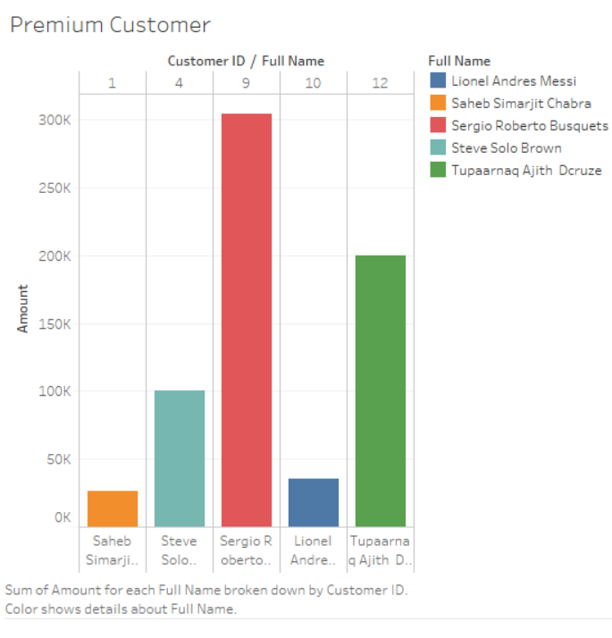
Premium Customers
Visualization represents the top five customers in terms of account balance.

Slide 11
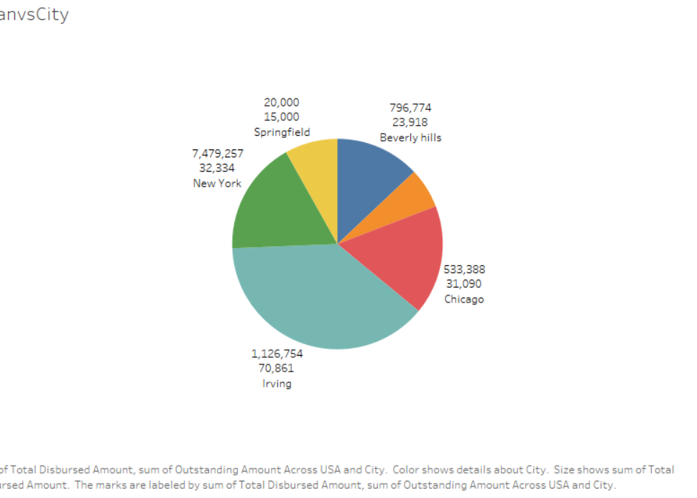
Loan Versus City
Visualization represents the Total disbursed Loan amount versus Cities

Slide 12
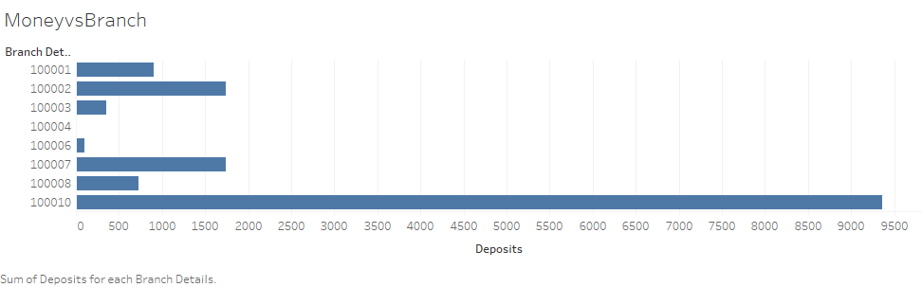
Money versus Branch
Visualization represents the money deposited in each branch

Slide 13
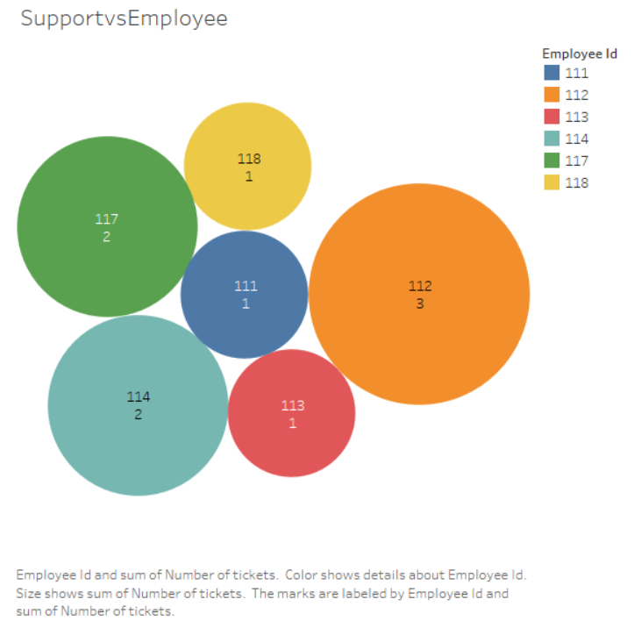
Support Versus Employee
Visualization represents the number of support tickets resolved by an Employee

